Slide 1

Design and Analysis of CRISPR-Cas Experiments

Slide 2

Presenter: Mahtab Kalani
Advisor: Dr. Motevasel
Shiraz University of Medical Sciences
School of Paramedical Sciences
1

Slide 3

What is CRISPR?
CRISPR Experiments
Design and Selection of Guide RNAs
Analysis of the result of Experiments
CRISPR
2

Slide 4
CRISPR
lustered
egularly
nterspaced
hort
alindromic
epeats
3

Slide 5
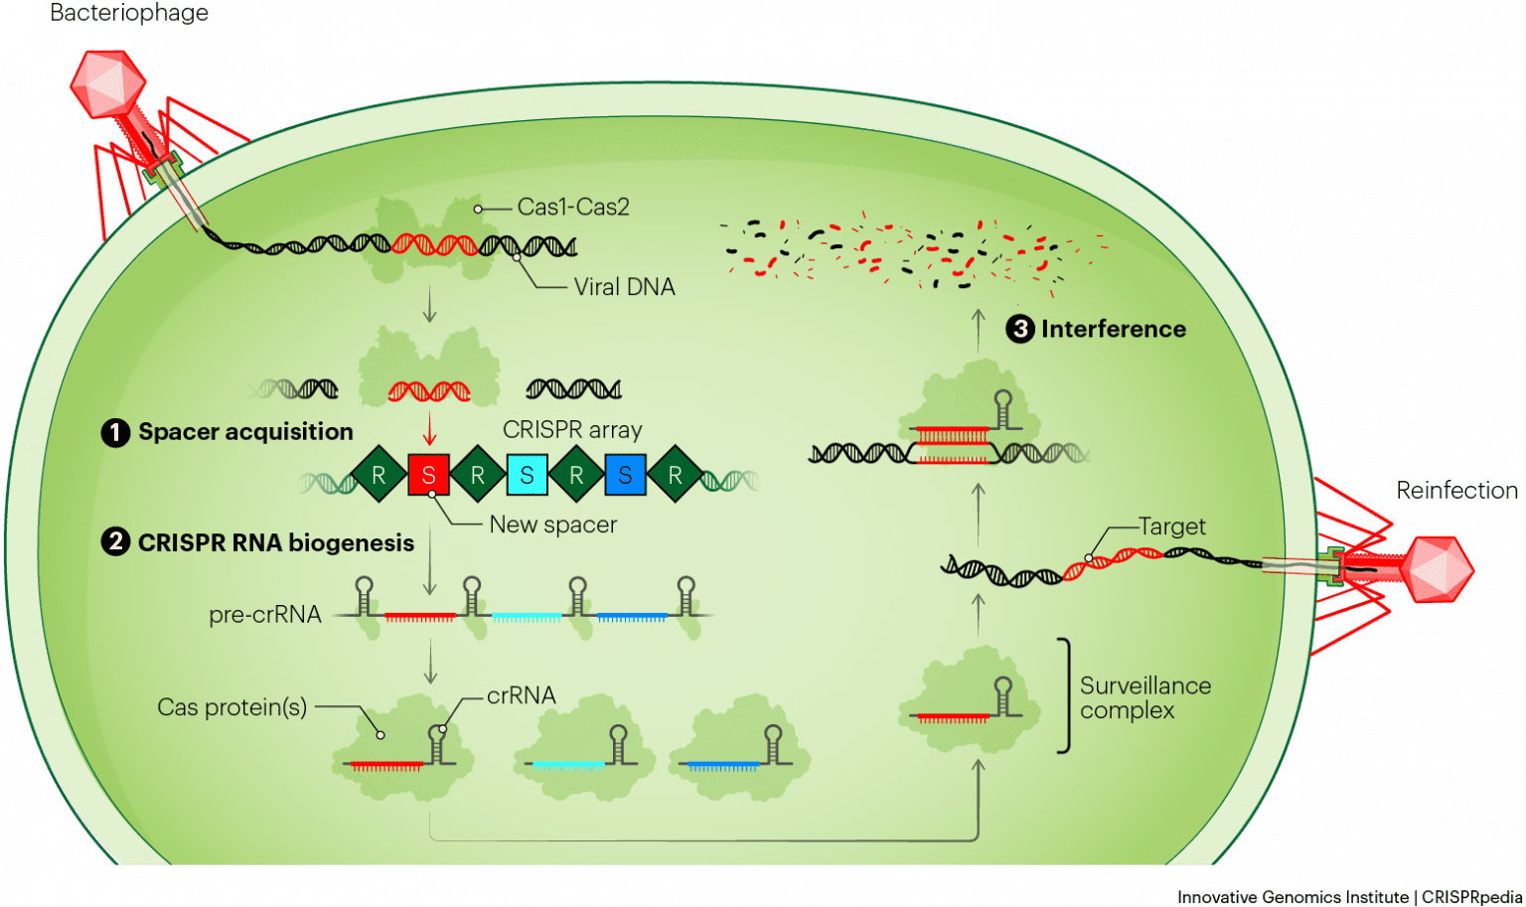
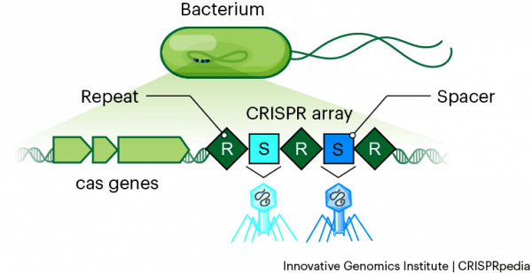
Bacteriophage
The CRISPR immune system
Reinfection
4
Innovative Genomics Institute | CRISPRpedia

Slide 6

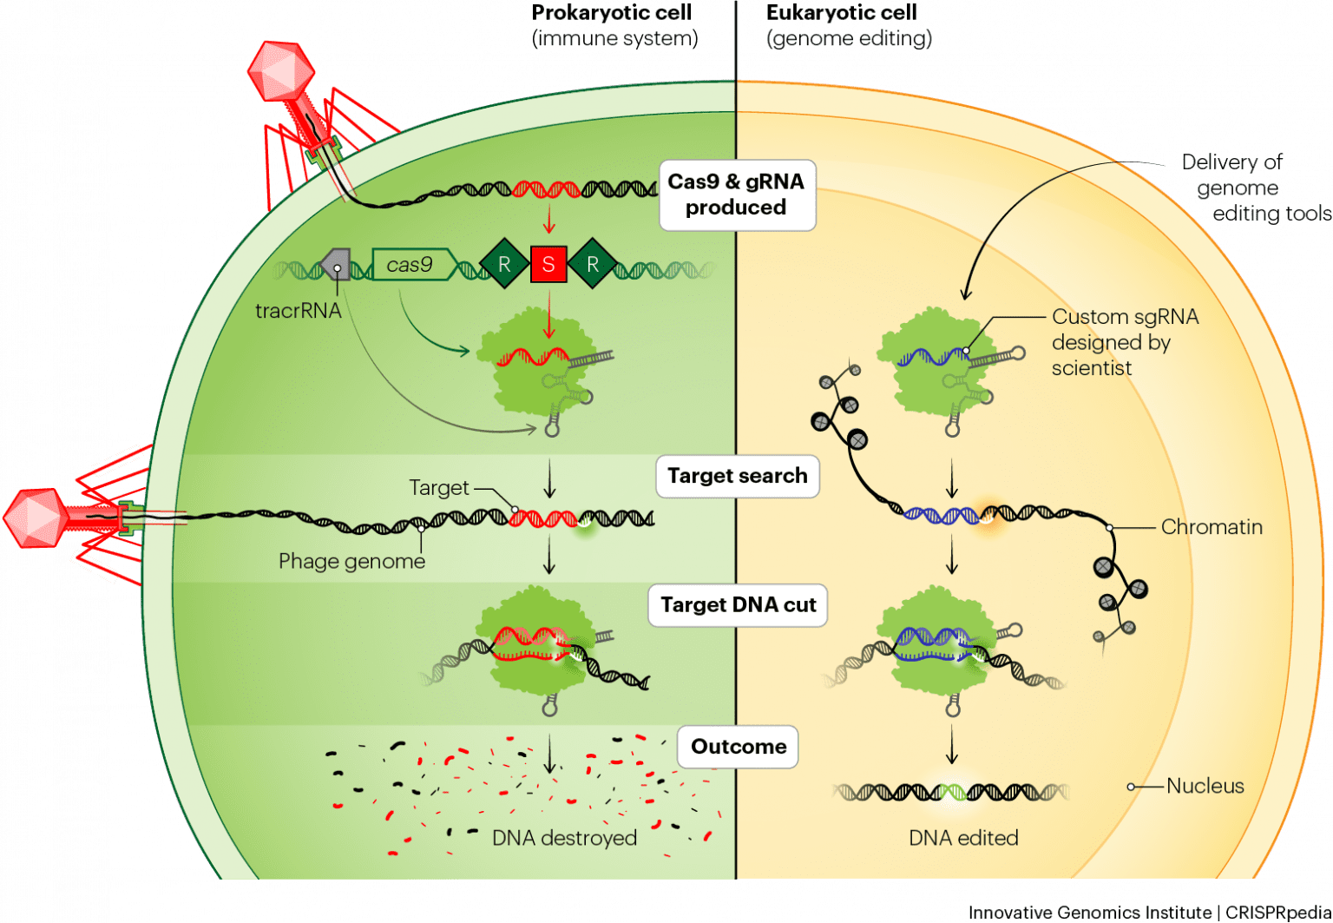
Prokaryotic cell
(immune system)
Eukaryotic cell
(genome editing)
5
Innovative Genomics Institute | CRISPRpedia

Slide 7
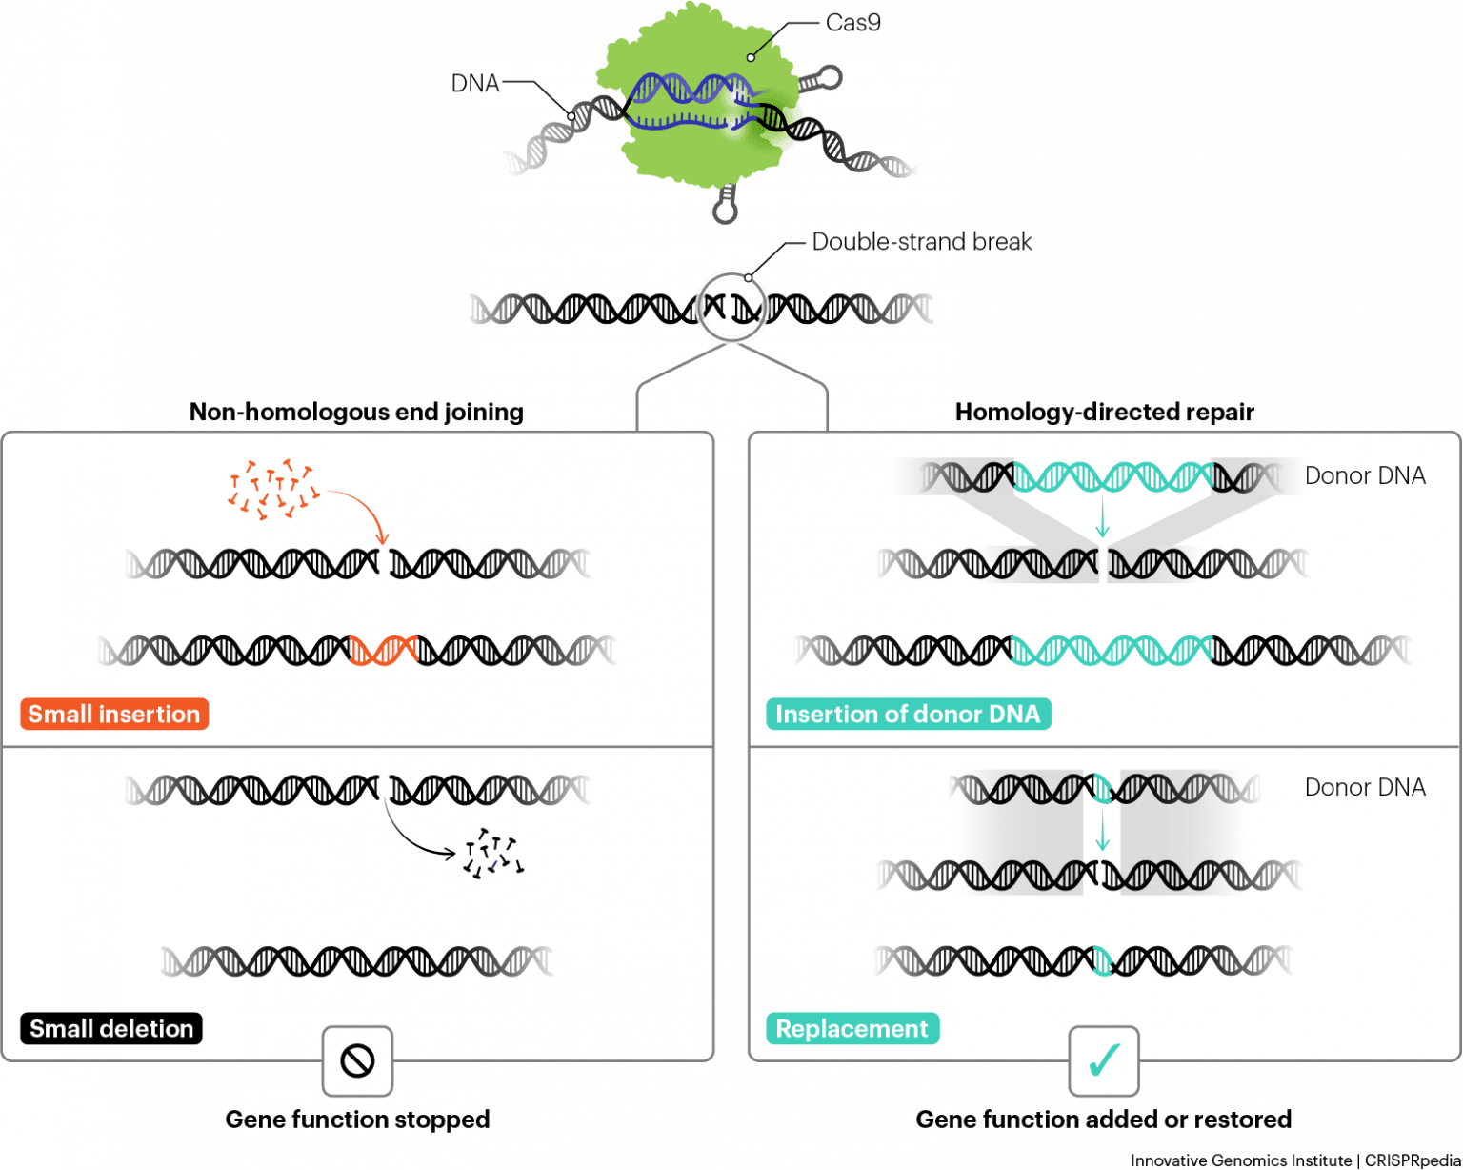
DSB
Gene function restored or added
Gene function stopped
None-Homologous End Joining
Homology Directed Repair
6
Innovative Genomics Institute | CRISPRpedia

Slide 8
specific base changes are created
Editing Experiments
Knockout Experiments
Recruitment Experiments
insertions and deletions are created
Cas protein with nuclease domains inactivated is programmed to directly or indirectly recruit another protein
7

Slide 9
Large-scale Experiments
Small-scale Experiments
8

Slide 10
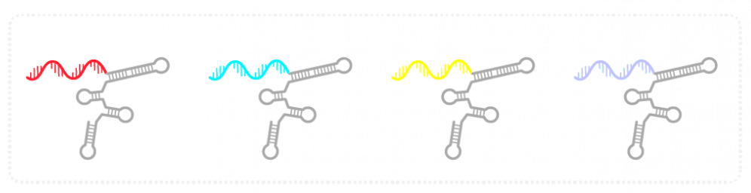
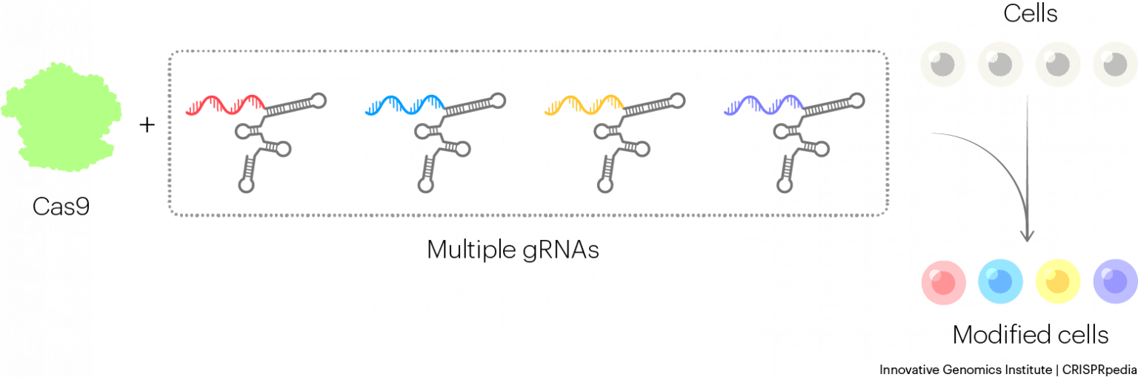
CAS 9
Screening Experiments
Cas9
Multiple gRNAs
Cells
Modified cells
9
Innovative Genomics Institute | CRISPRpedia

Slide 11
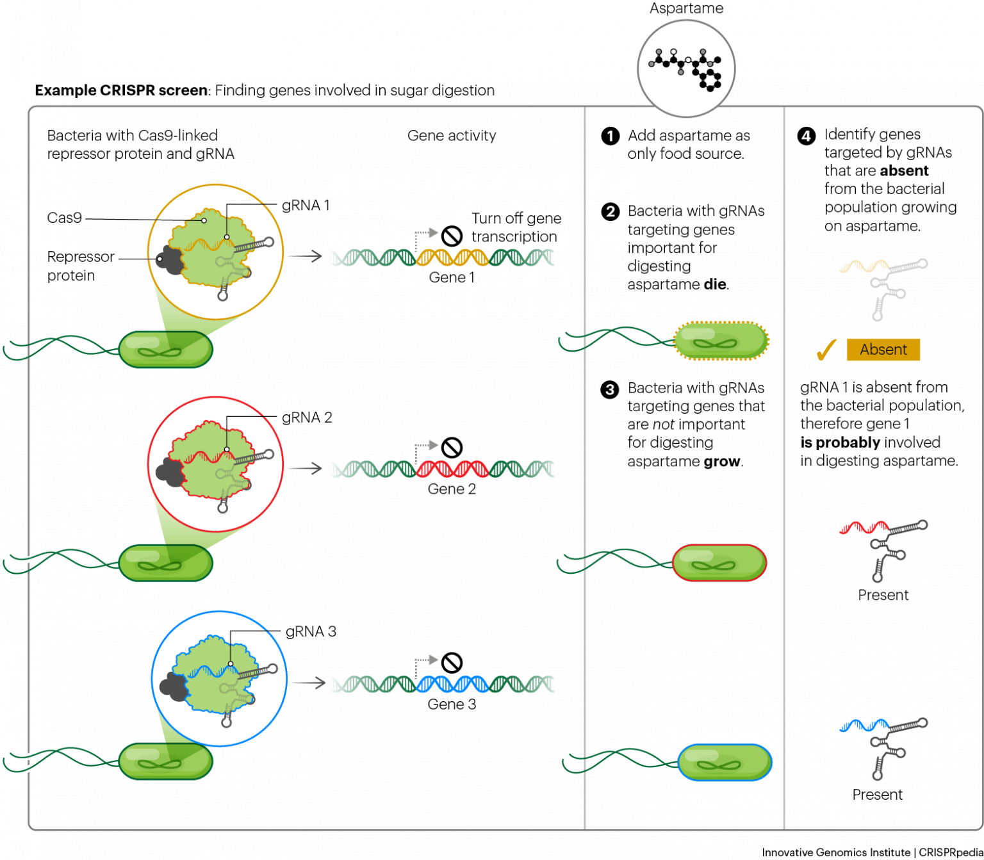
Aspartame
10
Innovative Genomics Institute | CRISPRpedia

Slide 12


Design and Selection of Guide RNAs
Protospacer adjacent motif (PAM)
11
Innovative Genomics Institute | CRISPRpedia

Slide 13
Design and Selection of Guide RNAs
Protospacer adjacent motif (PAM)
Cas Enzyme | PAM Sequence
Streptococcus pyogenes Cas9 (SpCas9) | NGG
Streptococcus thermophilus Cas9 (StCas9) | NNAGAAW
W = Adenine or Thymine
N = Any nucleotide
G = Guanine
A = Adenine
12

Slide 14
Development of Cas Variants
Cas Enzyme | PAM Sequence
SpCas9-VQR | NGAN or NGNG
SpCas9-NG | NG
13

Slide 15
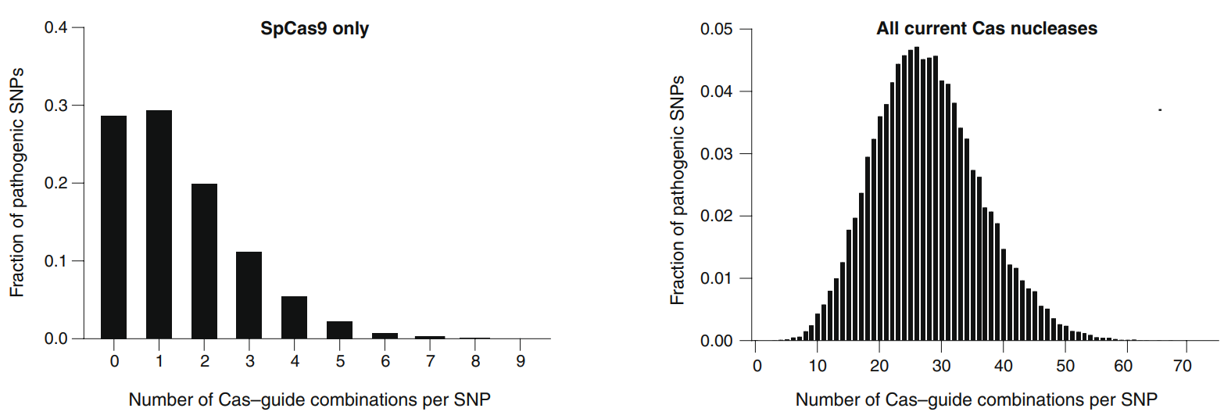
Little Flexibility to choose guides that are highly effective and specific
14

Slide 16
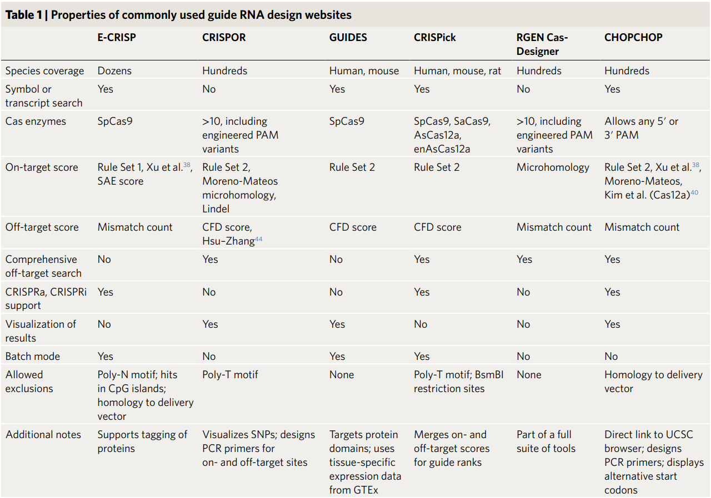
On-target effect
Website Features
15
Off-target effect

Slide 17
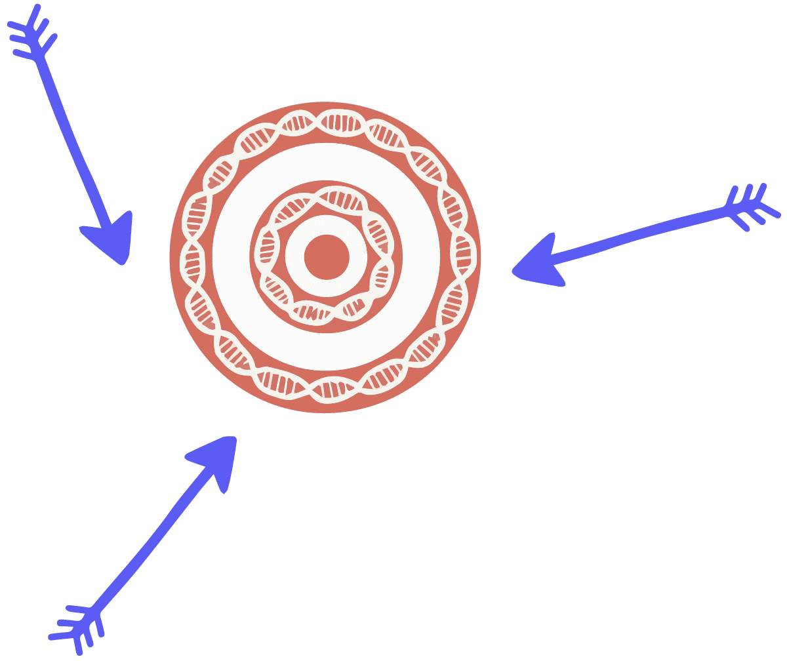
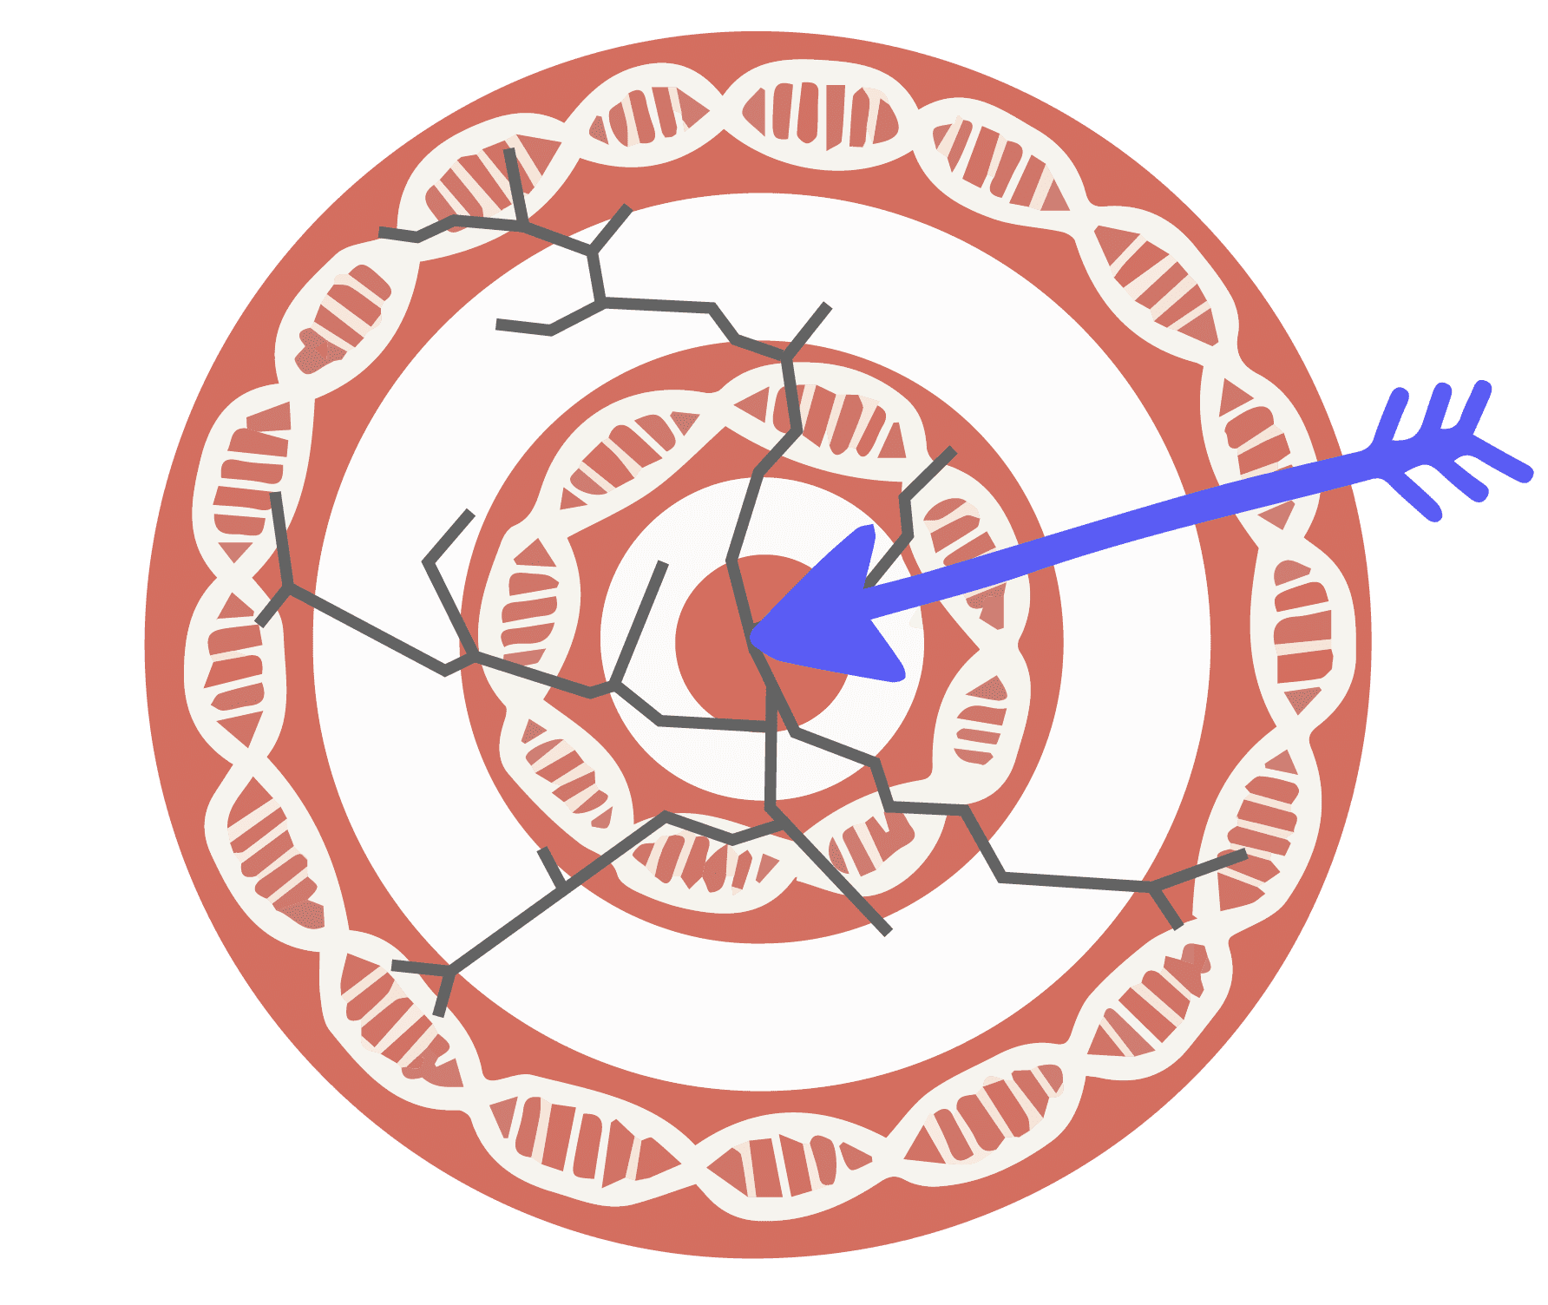
Off-target effect
On-target effect
When a genome engineering enzyme cuts DNA at an unintended, "off-target," site that is similar to the intended target.
When a genome-editing enzyme cuts DNA at the intended ”on-target” site, but makes a different change to the DNA than desired.
16

Slide 18


https://www.addgene.org/crispr/
17

Slide 19
!
!
!
Not necessarily reflecting one being right and the other wrong
If the experiment allows, there is no substitute for empirically testing several guides.
18

Slide 20

References
Design and analysis of CRISPR–Cas experiments, nature biotechnology,2020
https://innovativegenomics.org/crisprpedia/crispr-technology/
https://innovativegenomics.org/crisprpedia/crispr-in-nature/
High-content CRISPR screening, nature, 2022
19

Slide 21

Thanks For Your Attention!
Tanks For Your Attention!
CAS9

