Slide 1
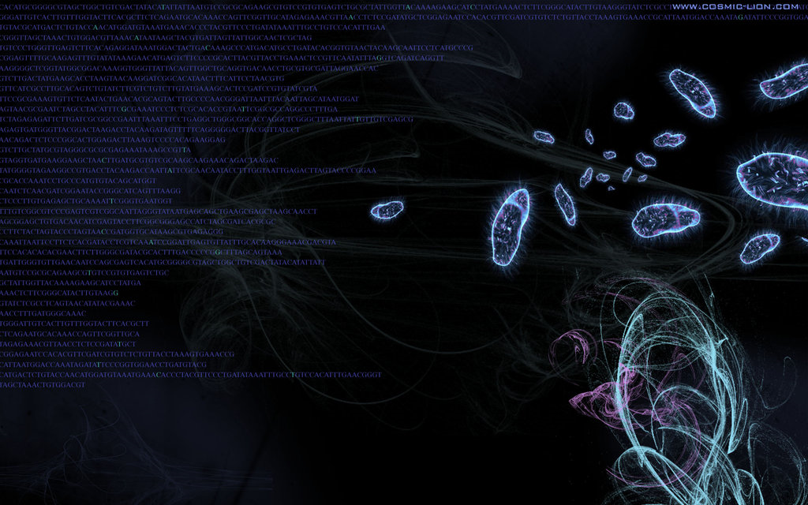

MacConkey Agar
آزمایشگاه میکروب شناسی
استاد درس: دکترمتوسل
گروه 9
نگین صفرپور
مهتاب کلانی

Slide 2

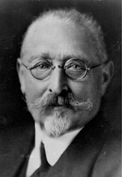
History of MacConkey Agar
First solid differential media
was developed at 20th century
Alfred Theodore MacConkey (1861-1931)

Slide 3
Composition of MacConkey Agar
Ingredients | Amount
Peptone (Pancreatic digest of gelatin) | 17 g
Proteose peptone (meat and casein) | 3 g
Crystal Violet | 0.001 g
Bile salts | 1.5 g
Sodium chloride | 5 g
Neutral red | 0.03 g
Lactose monohydrate | 10 g
Agar | 13.5 g
Distilled Water | Add to make 1 Liter
Nutrition source
inhibitor
maintains the osmotic balance in the medium.
PH indicator
Carbohydrate source

Slide 4
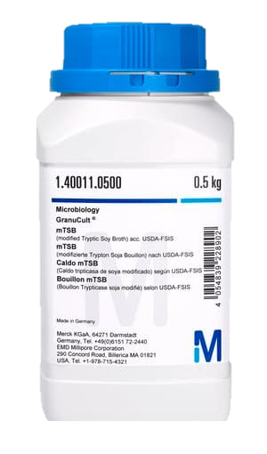
Preparation
Suspend the components, dehydrated powder, in water (49.53 grams in 1000 ml of purified / distilled water).
The medium is boiled for a few seconds until the ingredients are completely dissolved. Sterilize by autoclaving at 15 lbs (121°C) pressure for 15 minutes.
Cool to 45-50°C, mix well and pour about 20- 25ml into sterile Petri plates and allow to solidify.
After solidification of the plates, label the media plates with the name and date of preparation (on the backside of the media as lids could be interchanged)

Slide 5
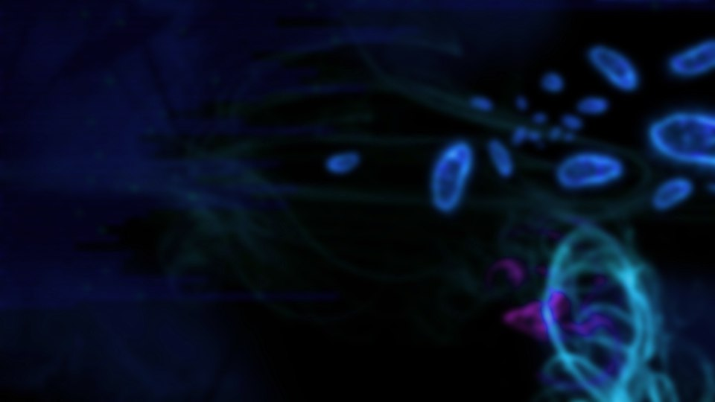
Storage of MacConkey agar
Store inverted (with lids down) at 2-8°C.
Media should not be used if there are any signs of deterioration (shrinking, cracking, or discoloration), contamination.
The product is light and temperature-sensitive; protects from light, excessive heat, moisture, and freezing.

Slide 6
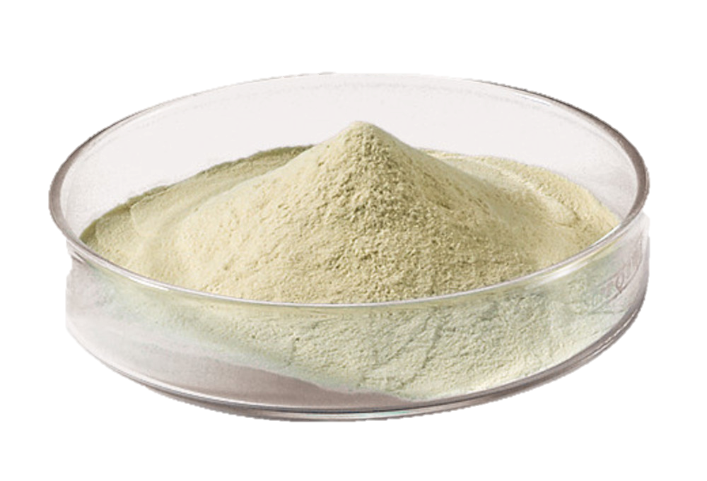
Nutrient Source
Pancreatic digest of gelatin and peptones (meat and casein) provide the essential nutrients, vitamins, and nitrogenous factors required for the growth of microorganisms.`
peptone

Slide 7
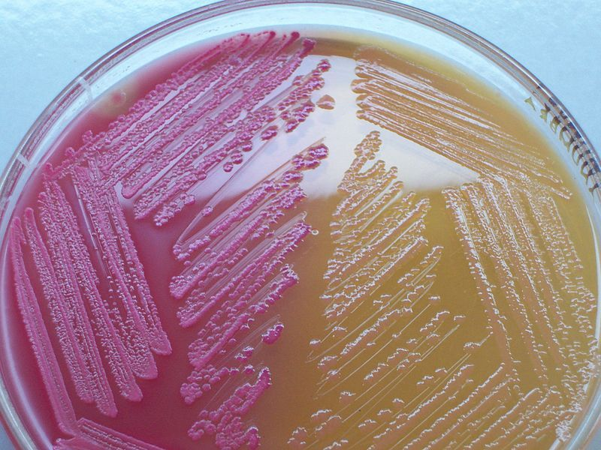
Principle of MacConkey Agar
MacConkey agar (MAC) is a selective and differential bacterial culture media commonly used for the isolation of Gram-negative enteric bacteria.
Selective as it allows the growth of gram-negative bacteria.
Differential as it differentiates the gram-negative bacteria based on their lactose metabolism.
Lactose fermenters
Non-Lactose fermenters

Slide 8
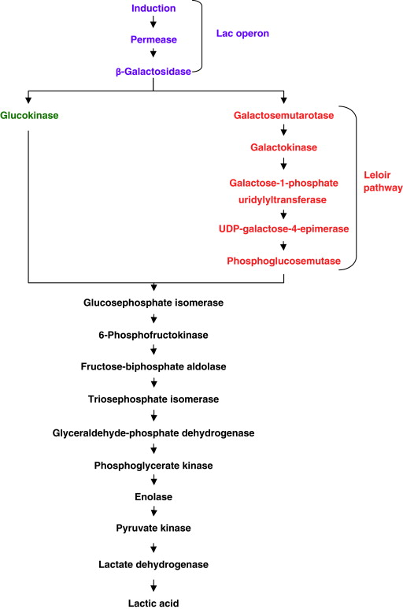
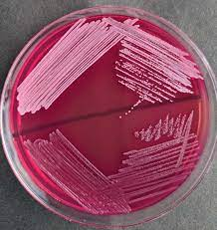
Metabolism of Lactose fermenters
-Bacteria which ferment lactose decrease the PH of the medium by enzymes like beta-galactosidase and beta-galactoside permease.
The decrease is detected by the PH indicator (neutral red). (become red if PH below 6.8)
When the pH drops, the neutral red is absorbed by bacteria, which appear as bright pink to red colonies on the agar.
A pink halo around colonies can be seen.
Escherichia coli
Enterobacteria
Klebsiella
pH<6.8

Slide 9
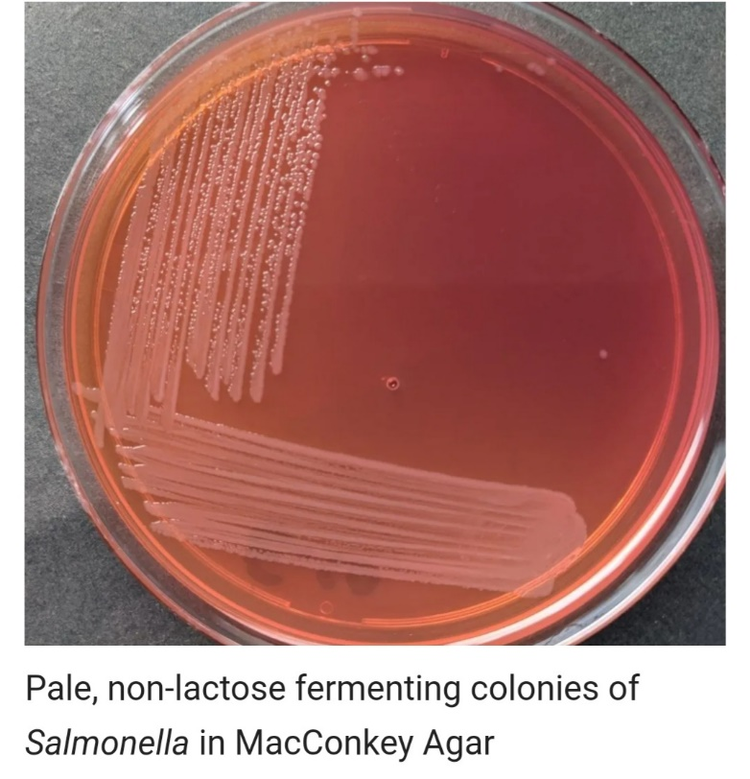
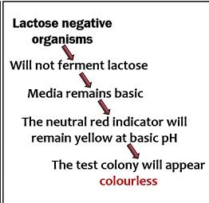
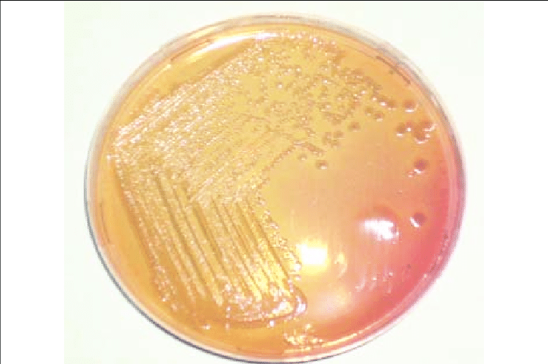
Non-Lactose fermenters
Gram negative bacteria that thrive on MacConkey agar but do not ferment lactose appear colorless on the medium (at any PH grater than 6.8) and the agar surrounding the bacteria remains relatively transparent.
Salmonella
Proteus
Yersinia
Pseudomonas

Slide 10
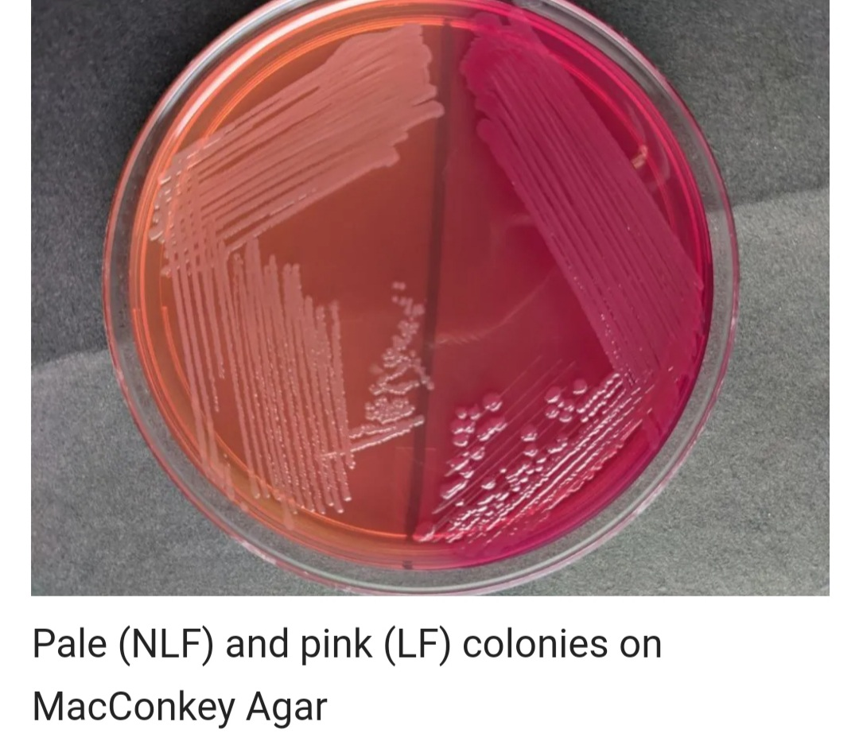
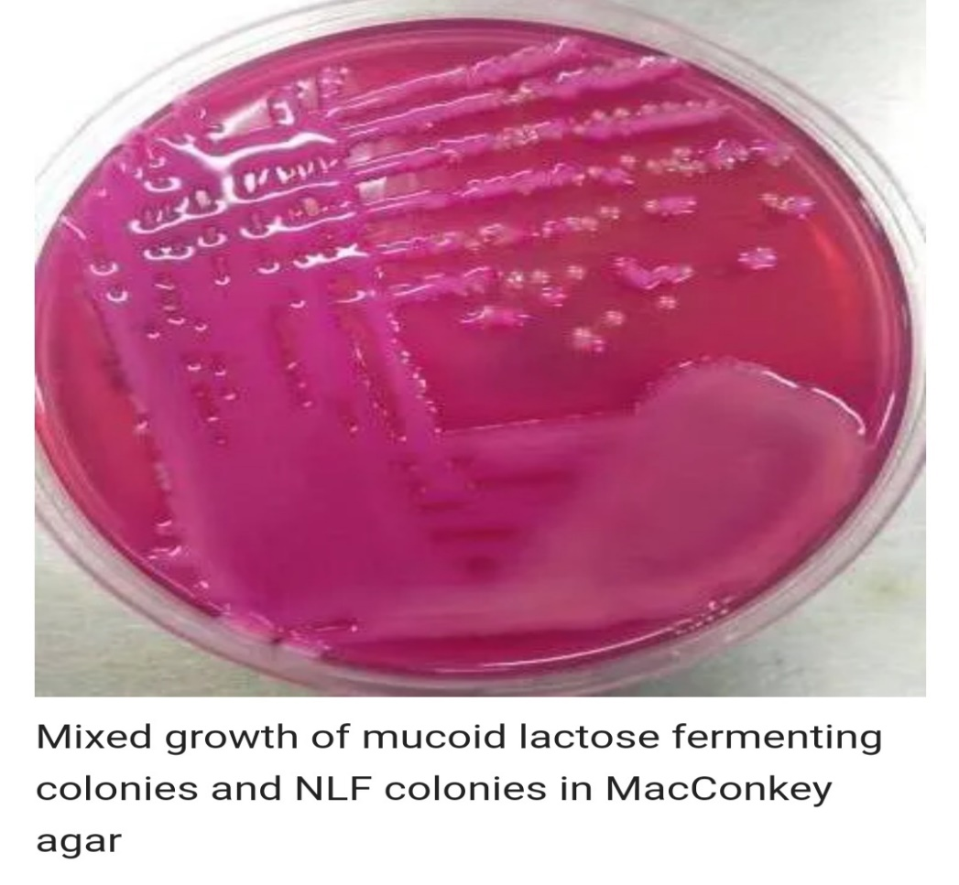
LF colony VS NLF colony

Slide 11
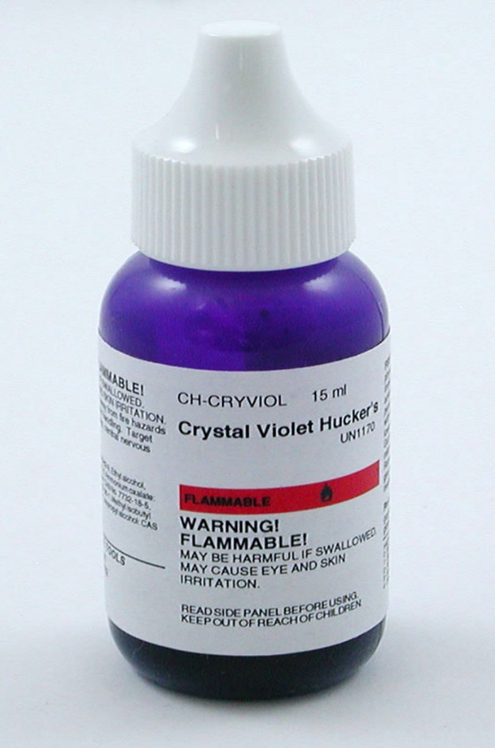
Inhibition
Crystal violet dye and bile salts prevent the growth of Gram-positive bacteria and fastidious Gram-negative bacteria (such as Neisseria and Pasteurella) making it favorable for the growth of gram-negative bacteria.
Since Gram-negative enteric bacteria possess a bile-resistant outer membrane, they remain unaffected by bile salts.

Slide 12
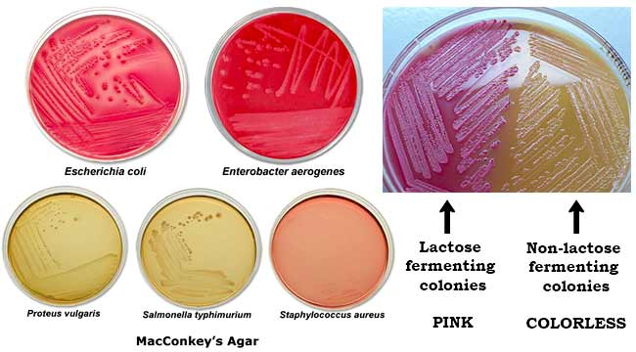
Gram positive (no growth)

Slide 13
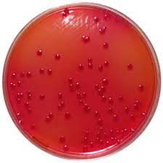
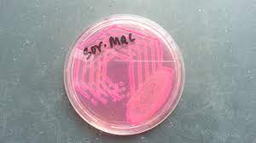
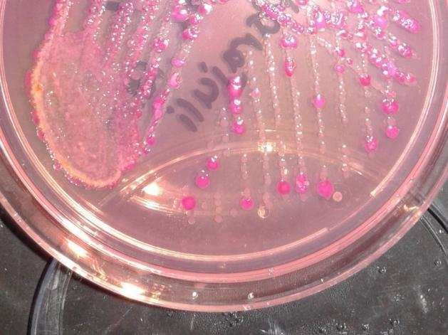
Variants of MacConkey agar
MacConkey with sorbitol
MacConkey agar without crystal violet and salt
MacConkey with sorbitol
MacConkey without crystal violet and salt

Slide 14
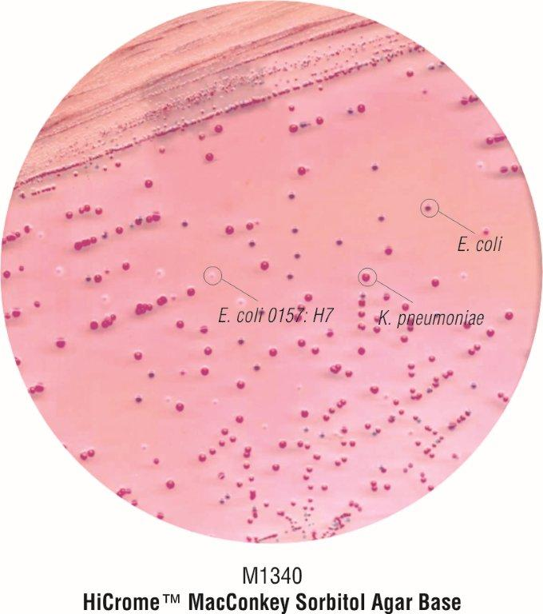
1- MacConkey with Sorbitol (Sorbitol-containing MacConkey agar (SMAC))
Sorbitol fermenting
Sorbitol MacConkey agar is a variant of MacConkey agar, it contains sorbitol instead of lactose as fermentable sugar.
Sorbitol-fermenting organisms produce pink colonies ( like most E. coli strains and other enterobacteria ferment sorbitol).
Non-sorbitol fermenting organisms like E.coli O157 produce colorless colonies.
Non-sorbitol fermenting

Slide 15
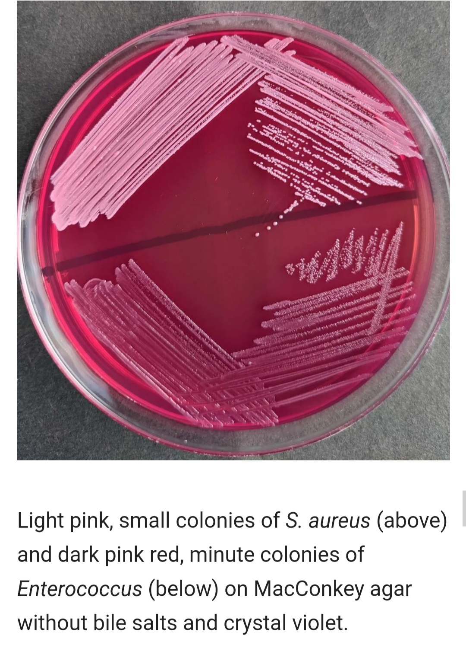
2- MacConkey without crystal violet and salt
It is a differential medium but is less selective than MacConkey agar.
Sodium chloride is removed from the medium to provide an electrolyte deficient medium preventing Proteus spp from spreading.
In addition, this medium does not contain crystal violet allowing the growth of Staphylococcus, Enterococcus and Mycobacterium spp.

Slide 16
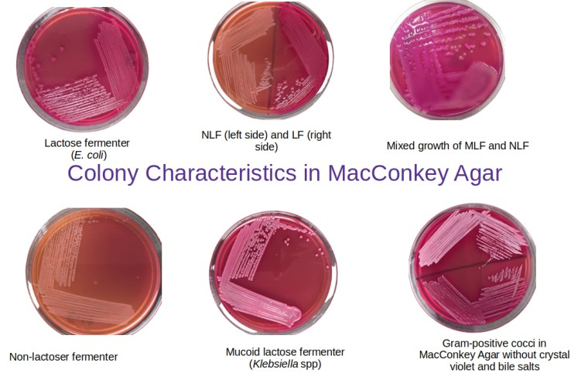
راست
چپ

Slide 17

سپاس از توجه شما

