Slide 1

Irritable Bowel Syndrome
Mahtab Kalani

Slide 2


INTRODUCTION
Irritable Bowel Syndrome (IBS) is a chronic functional disorder of the gastrointestinal tract characterized by chronic abdominal pain and altered bowel habits in the absence of an organic disease
Approximately 10 to 15 percent of adults and adolescents have symptoms consistent with IBS

Slide 3

DEFINITION
Irritable bowel syndrome is defined as recurrent abdominal pain on average, at least one day per week in the last three months
With two or more of the following related to defecation:
  associated with a change in frequency of stool
  or associated with a change in form (appearance) of stool

Slide 4
IBS Subtypes
IBS with constipation (IBS-C)
Patient reports that abnormal bowel movements are usually constipation
IBS with diarrhea (IBS-D)
Patient reports that abnormal bowel movements are usually diarrhea
Mixed IBS (IBS-M)
Patient reports that abnormal bowel movements are usually both constipation and diarrhea (more than one-fourth of all the abnormal bowel movements were constipation and more than one-fourth were diarrhea)
Unclassified IBS
Patients who meet diagnostic criteria for IBS but cannot be accurately categorized into one of the other three subtypes

Slide 5

EPIDEMIOLOGY
Prevalence of IBS in North America estimated from population-based studies is approximately 10 to 15 percent
In a meta-analysis that included eight international studies, the pooled prevalence of IBS was estimated to be 11 percent, with wide variation by geographic reign
The prevalence of IBS was 25 percent lower in those aged over 50 years as compared with those who were younger

Slide 6
EPIDEMIOLOGY
The overall prevalence of IBS in women was higher as compared with men
This relative difference reflects an absolute difference in prevalence of approximately 5 percent between the sexes, with a prevalence in women and men of 14 and 9 percent
Women may be more likely to have constipation-predominant IBS as compared with men

Slide 7

Pathophysiology
GASTROINTESTINAL MOTILITY
VISCERAL HYPERSENSITIVITY
INTESTINAL INFLAMMATION
POSTINFECTIOUS
ALTERATION INALTERATION IN FECAL MICROFLORA
BACTERIAL OVERGROWTH
FOOD SENSITIVITY
GENETICS
PSYCHOSOCIAL DYSFUNCTION

Slide 8

GASTROINTESTINAL MOTILITY
No predominant pattern of motor activity has emerged as a marker
Motor abnormalities of the gastrointestinal tract are detectable in some patients
The relevance of motor function alterations to symptoms has yet to be established
Pharmacologic stimulation of gut motility in IBS patients has been reported to reduce gas retention and improve symptoms

Slide 9
VISCERAL HYPERSENSITIVITY
A frequent finding in IBS patients
Perception in the gastrointestinal (GI) tract results from stimulation of various receptors in the gut wall
These receptors transmit signals via afferent neural pathways to the brain.
Local GI nervous system
Heightened sensitivity of the intestines to normal sensations
?
central modulation from the brain

Slide 10

CLINICAL MANIFESTATIONS
Chronic abdominal pain | Altered bowel habits
Cramping sensation with variable intensity | Diarrhea
Periodic exacerbations | Constipation
Various location and character of the pain | Alternating diarrhea and constipation
The pain may range from mild to severe
The pain is frequently related to defecation
In some patients abdominal pain is relieved with defecation, some patients report worsening of pain with defecation
Emotional stress and meals may exacerbate the pain
Increasing gas production

Slide 11

Dianosis
Initial Evaluation
History and physical examination
  The history should include exposure to a variety of medications that can cause similar symptoms
  A subgroup of patients report an acute viral or bacterial gastroenteritis prior to the onset of IBS symptoms

Slide 12
Dianosis
The physical examination is usually normal in patients with IBS. However, patients may have mild abdominal tenderness to palpation.
Family History Assessment
Colorectal cancer
Inflammatory bowel disease
Celiac disease

Slide 13
Dianosis
Laboratory Testing
No definitive diagnostic laboratory test for IBS
The purpose of laboratory testing is primarily to exclude an alternative diagnosis

Slide 14
Dianosis
Patients with suspected IBS
patients with diarrhea
Complete Blood Count
C-reactive protein and/or fecal calprotectin
Serologic testing for celiac disease
Other tests
Age-appropriate colorectal cancer screening in all patients
For IBS patients with constipation, abdominal radiograph

Slide 15

Treatment
INITIAL THERAPY
Establishment of a clinician-patient relationship and continuity of care are critical
Patients with mild and intermittent symptoms
Patients with mild to moderate symptoms who fail to respond to initial management
Patients with moderate to severe symptoms that affect quality of life
lifestyle and dietary modification are recommended alone
Pharmacologic therapy as adjunctive treatment

Slide 16
Treatment
Education and Reassurance
A therapeutic clinician-patient relationship should be established to validate the patient's symptoms
Patients should also be counseled that although IBS does not increase their risk of malignancy, it is a chronic disease

Slide 17
Treatment
Dietary modification
A careful dietary history may reveal patterns of symptoms related to specific foods
Insufficient evidence to support routine food allergy testing in patients with IBS

Slide 18
Gluten avoidance
Treatment
Lactose avoidance
Exclusion of gas-producing foods
Fiber
Low FODMAP diet
Physical activity

Slide 19
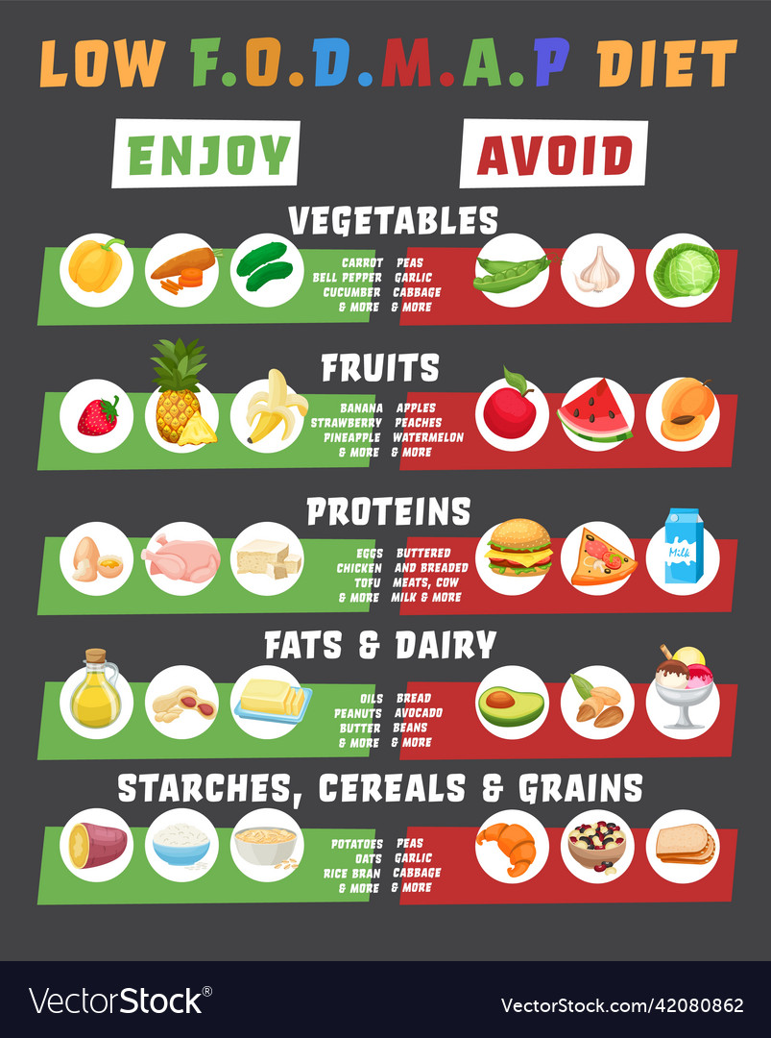
FODMAPs
A diet low in fermentable oligo-, di-, and monosaccharides and polyols (FODMAPs) in patients with IBS with abdominal bloating or pain despite exclusion of gas-producing foods

Slide 20
ADJUNCTIVE PHARMACOLOGIC THERAPY
Constipation
Diarrhea
Abdominal pain and bloating
Osmotic laxatives
Guanylate cyclase agonists
Antidiarrheal agents
Bile acid sequestrants
Antispasmodic agents
Lubiprostone
polyethylene glycol
5-hydroxytryptamine (serotonin) 3 receptor antagonists
5-hydroxytryptamine (serotonin) 4 receptor agonists
Probiotics
Antibiotics
Antidepressants

Slide 21

References
Up to Date: Treatment of irritable bowel syndrome in adults, Arnold Wald, MD
Up to Date: Pathophysiology of irritable bowel syndrome, Arnold Wald, MD
Up to Date: Clinical manifestations and diagnosis of irritable bowel syndrome in adults, Arnold Wald, MD

Slide 22


Keep your Bowels Healthy!!

